Slide 1
When X is Binary (Dummy)

Slide 2
One Binary Variable
Sometimes a regressor (X) is binary:
X = 1 if female, = 0 if male
X = 1 if treated (experimental drug), = 0 if not
X = 1 if small class size, = 0 if not
Binary regressors are sometimes called “dummy” variables
So far, β₁ has been called a “slope,” but that doesn’t make sense if X is binary
How do we interpret regression with a binary regressor?

Slide 3
One Binary Variable (Interpretation)
Y_{i} = β₀ + β₁X_{i} + u_{i},
where X is binary (X_{i} = 0 or 1)
When X_{i} = 0, Y_{i} = β₀ + u_{i}
The mean of Y_{i} is β₀
E(Y_{i}|X_{i}=0) = β₀
When X_{i} = 1, Y_{i} = β₀ + β₁ + u_{i}
The mean of Y_{i} is β₀ + β₁
E(Y_{i}|X_{i}=1) = β₀ + β₁
β₁ = E(Y_{i}|X_{i}=1) – E(Y_{i}|X_{i}=0)
Difference in group means between X_{i} = 0 and X_{i} = 1

Slide 4
Two Binary Variables are Independent
Y_{i} = β₀ + β₁D_{1i} + β₂D_{2i} + u_{i}
where D_{1i}, D_{2i} are binary
β₁ is the effect of changing D₁=0 to D₁=1. In this specification, this effect doesn’t depend on the value of D₂

Slide 5
Two Binary Variables are Dependent
To allow the effect of changing D₁ to depend on D₂, include the “interaction term” D_{1i}×D_{2i} as a regressor:
Y_{i} = β₀ + β₁D_{1i} + β₂D_{2i} + β₃(D_{1i}×D_{2i}) + u_{i}
General rule: compare the various cases
E(Y_{i}|D_{1i}=0, D_{2i}=d₂) = β₀ + β₂d₂ (b)
E(Y_{i}|D_{1i}=1, D_{2i}=d₂) = β₀ + β₁ + β₂d₂ + β₃d₂ (a)
subtract (a) – (b):
E(Y_{i}|D_{1i}=1, D_{2i}=d₂) – E(Y_{i}|D_{1i}=0, D_{2i}=d₂) = β₁ + β₃d₂
The effect of D₁ depends on d₂
β₃ = increment to the effect of D₁, when D₂ = 1
Or
increment to the effect of D₂, when D₁ = 1

Slide 6
Two Binary Variables are Dependent (example)
Y_{i} = β₀ + β₁D_{1i} + β₂D_{2i} + β₃(D_{1i}×D_{2i}) + u_{i}
Y_{i}: Health condition of individual i
D_{1i} = 1 if individual i does not smoke, otherwise 0
D_{2i} = 1 if individual i exercises for more than 3 hours a week, otherwise 0
What is your expectation about the signs of the coefficients?
β₁ : Positive
β₂ : Positive
β₃ :
Positive => Regular exercise without smoking induces healthier condition
Negative => Regular exercise without smoking worsens your healthy condition

Slide 7
Interaction between Binary and Continuous Variables

Slide 8
Binary and Continuous Variables 1
Y_{i} = β₀ + β₁X_{i} + β₂D_{i}+ u_{i}
D_{i} is binary, X is continuous
To allow the effect of X to depend on D, include the “interaction term” D_{i}×X_{i} as a regressor:
Y_{i} = β₀ + β₁X_{i} + β₂D_{i}+ β₃(D_{i}×X_{i}) + u_{i}

Slide 9
Binary and Continuous Variables 2
Y_{i} = β₀ + β₁X_{i} + β₂D_{i}+ β₃(D_{i}×X_{i}) + u_{i}
Observations with D_{i}= 0 (the “D = 0” group):
Y_{i} = β₀ + β₁X_{i} + u_{i} The D=0 regression line
Observations with D_{i}= 1 (the “D = 1” group):
Y_{i} = β₀ + β₁X_{i} + β₂+ β₃X_{i} + u_{i}
= (β₀+β₂) + (β₁+β₃)X_{i} + u_{i} The D=1 regression line

Slide 10
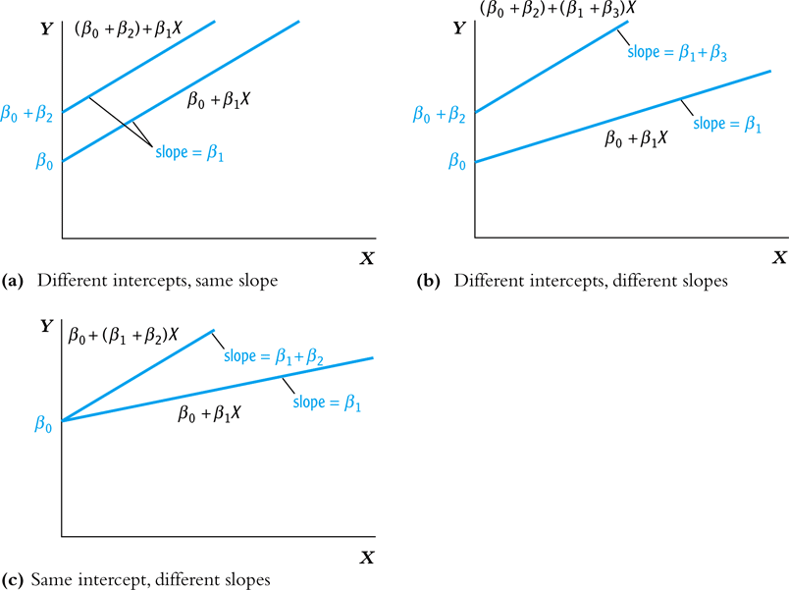
Binary and Continuous Variables 3

